Slide 1
SQL vs NoSQL
Presentation-comparison

Slide 2
SQL
SQL is a programming language that differs from a general-purpose programming language such as Python, Java, and JavaScript. It has a specific purpose: to access and manage data in relational databases. It uses relations (referred to as tables) with a schema to manage and store data
Some of the relational database examples which use SQL are
Oracle
Microsoft SQL server
Ingres
Microsoft office Access
IBM DB2
Sybase
Google Cloud SQL
Amazon RDS
PostgreSQL

Slide 3
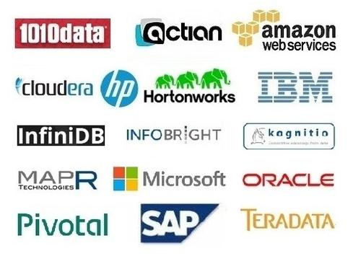
NOSQL
NoSQL stands for Not only SQL. It is a type of database that uses non-relational data structures, such as documents, graph databases, and key-value stores to store and retrieve data. NoSQL systems are designed to be more flexible than traditional relational databases and can scale up or down easily to accommodate changes in usage or load. This makes them ideal for use in applications
Some of the relational database
examples which use NOSQL are

Slide 4

A cross-platform, open-source document-oriented database application called MongoDB is free and available. MongoDB, a NoSQL database application, uses documents that resemble JSON and have schemas. A framework for data storage and retrieval is provided by a NoSQL database.
MongoDB | SQL
MongoDB is a document-based, non-relational database management system.Another name for it is an object-based system. | A table-based system is MySQL (or open-source relational database). The table-based architecture, which is regarded as a SQL database, is the data query structure for search.
Every record in MongoDB is kept as a separate document. | Each individual entry is saved as a “row” in a database in MySQL.
Documents from a specific class or group are kept in a “collection” | Rows (also known as records) of a similar sort are kept in a “table.”
MongoDB supports out-of-the-box replication and sharding and was built with high availability and scalability in mind. | Although the MySQL architecture does not support effective replication and sharding, one can access related data via joins in MySQL, which reduces duplication.
It was created by MongoDB Inc. and was made available on February 11, 2009. | On April 24, 1989, Microsoft Corporation first made this technology available.

Slide 5
Conclusion
First MongoDB is a database that is more advanced and capable of handling big data with dynamic schema features. SQL Server is an RDBMS that is used to manage the relational database system and offers end-to-end business data solutions. In the case of unstructured data MongoDB is a good choice. Also, MongoDB is open source which makes it readily available.
No doubt SQL Server is going strong for many years but now with the era of Big Data, MongoDB seems to have a bright future. But, that doesn’t mean SQL Server will be completely eradicated. The choice of database between MongoDB and SQL Server is completely specific to the user’s needs.

